Slide 1
Project Title
Weather App
Submitted By:
Hariom Singh
Section - H
(2115000991)
GLA University , Mathura
Department of Computer Engineering & Applications
23/11/2023

Slide 2
Introduction
The Weather App is a web-based application built using HTML, CSS, and JavaScript. Its primary purpose is to provide users with current weather information for a specified location. The app utilizes a weather API to fetch real-time data and dynamically updates the user interface to display key weather details such as temperature, humidity, and wind speed.
Creating a weather app using HTML, CSS, and JavaScript can be motivated by the desire to provide users with a simple and accessible tool to check weather conditions. It's a practical project for honing front-end development skills and integrating real-time data through APIs. Additionally, developing a weather app allows you to explore user interface design, data visualization, and interaction functionalities, making it a well-rounded project for web development learning.
The Weather App provides a user-friendly interface to quickly check current weather conditions for any location. Expect a clean design, easy input for locations, and instant access to key weather details such as temperature, humidity, and wind speed. Stay informed with a simple and intuitive tool for on-the-go weather updates.

Slide 3
Objectives
Current Weather Information: Provide users with real-time weather data, including temperature, humidity, and wind speed, for a specified location.
User-Friendly Interface: Design an intuitive and visually appealing interface to enhance the user experience, allowing easy input of locations and quick access to weather details.
Responsiveness: Ensure the app is responsive across various devices and screen sizes, enabling users to access weather information seamlessly on desktops, tablets, and mobile devices.
Educational Value: Offer an opportunity for developers to learn and practice front-end web development skills, including HTML, CSS, and JavaScript, while working on a practical and real-world project.
Accessibility: Consider accessibility principles to make the app inclusive and usable for individuals with diverse needs, including those with disabilities.
Aim:- The aim of a weather app project is typically to provide users with accurate and up-to-date weather information. This includes current conditions, forecasts, and potentially additional features like radar images or severe weather alerts. The goal is to offer users a convenient way to access relevant weather data for planning activities or staying informed about local conditions.

Slide 4
Problem Statement
The problem addressed by a weather app is the need for accessible and real-time information about current and future weather conditions. People require accurate forecasts and timely updates to plan their daily activities, travel, and make informed decisions based on the weather. The app aims to streamline and enhance the way users access this crucial information, providing a user-friendly interface for weather-related data.
Importance -
Planning and Safety: Users rely on weather apps to plan their activities, whether it's scheduling outdoor events, commuting, or making travel arrangements. Additionally, access to weather warnings helps people stay prepared for severe conditions, enhancing safety.
Real-time Updates: Weather conditions can change rapidly. A weather app provides real-time updates, ensuring users have the latest information to adapt their plans accordingly.
Efficient Decision-Making: Having accurate and readily available weather information enables users to make informed decisions, saving time and resources by avoiding unfavorable conditions.
Convenience: Weather apps provide a convenient way for users to access detailed weather information at their fingertips, eliminating the need to rely on traditional sources like TV or radio.

Slide 5
Literature Review
Projects in the same domain -
The Weather Channel: Known for its detailed forecasts, The Weather Channel app provides hourly and 10-day forecasts, radar maps, and video updates. It also features severe weather alerts and a hurricane tracker.
Dark Sky (now part of Apple): Dark Sky is known for its hyper-local weather forecasts, providing minute-by-minute precipitation predictions. It focuses on simplicity and accuracy in weather reporting.
The gap this project is filling –
Minute-by-Minute Accuracy: The project emphasizes hyper-local and real-time weather updates, offering minute-by-minute accuracy. This addresses the gap in providing users with the most precise and immediate information about changing weather conditions, ensuring timely decision-making.
Unified User Experience: Recognizing the need for a streamlined and cohesive experience, the app aims to unify diverse weather information into a seamless interface. This addresses the gap in presenting comprehensive weather data in a way that is both intuitive and accessible for users with varying levels of meteorological knowledge.

Slide 6
Methodology
The approach taken to address the challenges in the weather app project –
Responsive Web Design: Utilized HTML, CSS, and JavaScript to create a responsive and user-friendly web interface. Ensured that the app adapts seamlessly to various screen sizes and devices, providing a consistent experience for users across platforms.
Testing and Feedback Loop: Conducted rigorous testing, including functional testing, usability testing, and performance testing. User feedback was actively sought and incorporated to identify and address any issues, ensuring a polished and reliable user experience.
Security Measures: Implemented security measures to protect user data and ensure the app's overall security. This included encryption protocols for data transmission and storage, as well as other industry-standard security practices.

Slide 7
Methodology
Algorithms and Techniques: Forecasting Algorithms: Utilized advanced forecasting algorithms, potentially incorporating statistical models, machine learning, and numerical weather prediction techniques to enhance the accuracy of weather predictions.
Data Analysis: Employed data analysis techniques to process and interpret large sets of meteorological data, extracting meaningful patterns and trends for more precise forecasting.
Tools: Integrated Development Environment (IDE): Used an IDE like Visual Studio Code for coding and development.
Languages: HTML, CSS, JavaScript (Frontend): Created a responsive and interactive user interface using HTML for structure, CSS for styling, and JavaScript for dynamic behaviour.
JavaScript (Backend): Leveraged JavaScript, possibly with Node.js, for server-side development to handle backend logic, API integrations, and real-time updates

Slide 8
System Architecture
User Interface (UI): The front-end where users interact with the app, view weather information, and input locations.
Network Communication: Handling network requests to communicate with the weather API and ensuring a reliable data exchange.
Data Storage: A database or local storage to cache frequently requested weather data, reducing the need to make repeated API calls for the same location.
Error Handling: Robust mechanisms to handle errors gracefully and provide meaningful feedback to users when there are issues fetching or processing data.
Security: Ensuring the security of user data and communications, especially if the app requires user accounts or personalization features.
Updates and Maintenance: A mechanism to update the app with new features, bug fixes, and the latest weather data.

Slide 9
Implementation
1.Sign up for an API Key
2.HTML Structure
3. CSS Styling
4. Javascript to call api to fetch weather details

Slide 10
Features
1. Location-based Forecast 2. Current Conditions
3. Forecast 4. Interactive Maps
5. Alerts and Notifications 6. Multiple Locations
7. Historical Data 8. User-Friendly Design
Customization 10. Accessibility
The success of these unique features depends on your target audience and the overall usability of the app. Always prioritize functionality that enhances the user experience and provides valuable, relevant information.

Slide 11
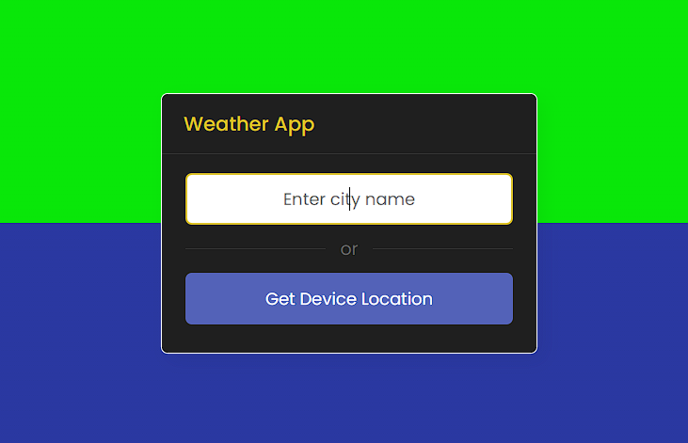
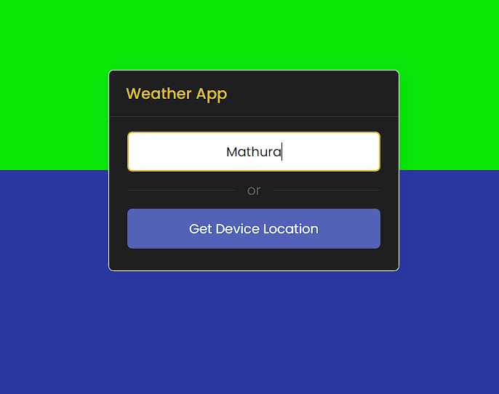
Results

Slide 12
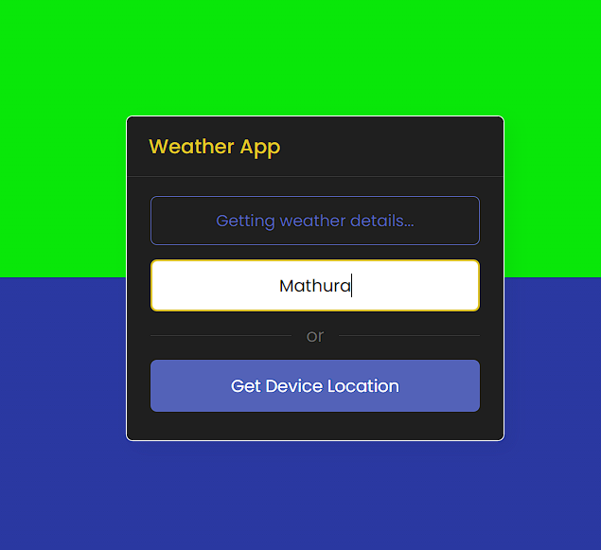
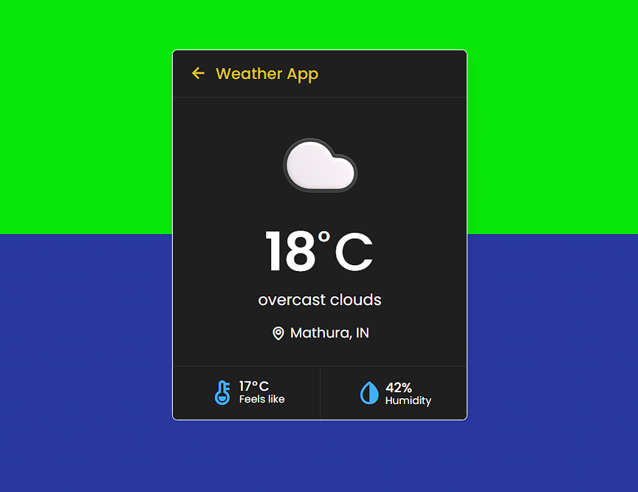
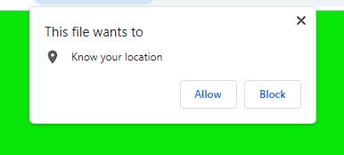

Slide 13
Challenges Faced
One significant challenge during the weather app project was integrating real-time weather data. Accessing and maintaining up-to-date information posed difficulties due to varying APIs and data formats. Overcoming this, I implemented robust error handling and regularly updated the API calls to align with changes in data structures. Additionally, caching mechanisms were employed to optimize data retrieval and minimize API calls, enhancing the app's efficiency and reliability.

Slide 14
Future Work
To enhance the weather app in the future, consider implementing the following improvements:
1.User Personalization 2.Detaled Forecasting 3.Interative Maps 4.Push Notifications
5.Social Integration 6.Accessibility Features 7.Performance Optimization
8.Localization and Internationalization 9.Feedback Machanism
Some additional features and functionalities that could enhance a weather app:
Weather Widgets 2. Travel Planner 3. Air Quality Information
4. Weather History 5. Weather-Related News 6. Weather Challenges and Achievements
7. Astronomy Information

Slide 15
Conclusion
User-Centric Approach: The Weather Application Website has been developed with a usercentric approach, prioritizing the needs and preferences of users. The intuitive user interface, coupled with customizable features, ensures that users can effortlessly access the weather information most relevant to them. 2. Real-Time and Forecast Data: The integration of reliable weather APIs enables the website to deliver real-time weather updates and precise forecasts. Users can trust the accuracy of the information provided, empowering them to make informed decisions based on current and future weather conditions. 3. Multifaceted Functionality: The website offers a range of features, including interactive maps, historical weather data access, and personalized user profiles. These functionalities cater to a diverse user base, from casual users seeking quick weather updates to enthusiasts interested in in-depth weather analyses

Slide 16
Acknowledgments
We sincerely express our deep gratitude to the management of our college for giving us liberty to choose and to work on the most relevant project i.e. “Weather App”. We are thankful to Mr. Rohit Agarwal (HOD CSE) for ensuring that we have a smooth environment at the college and lab. At the very outset we would like to offer our never ending thanks to our project supervisor Er. Sanjay Madaan(Technical Trainer, CSA) who helped us with our project from the beginning till the end. His continuous surveillance over our work allowed us to work more efficiently

Slide 17
THANK YOU

